Slide 1
Thyroid Hormones
and Thermogenesis

Slide 2
Types and biosynthesis of
thyroid hormones
Thyroxine (T4) and tri-iodothyronine (T3)
Synthesized in the thyroid gland by:
  Iodination
  Coupling of two tyrosine molecules
  Attaching to thyroglobulin protein
Thyroid gland mostly secretes T4
Peripheral tissues (liver, kidney, etc.) deiodinate T4 to T3

Slide 3
Types and biosynthesis of
thyroid hormones
T3 is more biologically active form
T4 can be converted to rT3 (reverse T3) – inactive form
Most of T4 is transported in plasma as protein-bound
  Thyroglobulin-bound (70%)
  Albumin-bound (25%)
  Transthyretin-bound (5%)
The unbound (free) form of T4 and T3 are biologically active

Slide 4
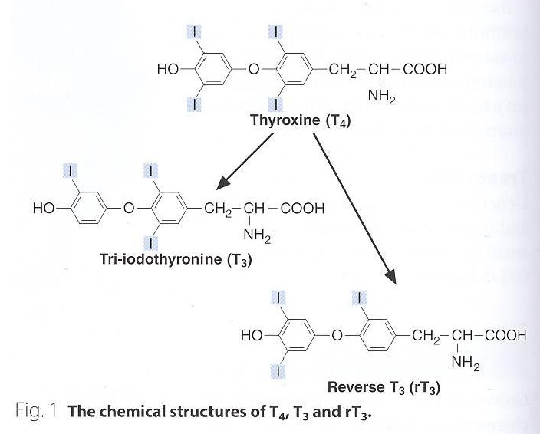
Plasma level: 100 nmol/L
Plasma level:
2 nmol/L

Slide 5
Thyroid hormone action
Essential for normal maturation and metabolism of all body tissues
Affects the rate of protein, carbohydrate and lipid metabolism
Control energy metabolism and protein synthesis
Regulates thermogenesis

Slide 6
Thyroid hormone action
Hypothyroid children have delayed skeletal maturation, short stature, delayed puberty
Untreated congenital hypothyroidism causes permanent brain damage
Hypothyroid patients have high serum cholesterol due to:
  Down regulation of LDL receptors on liver cells
  Failure of sterol excretion via the gut

Slide 7
Regulation of thyroid hormone secretion
The hypothalamic-pituitary-thyroid axis regulates thyroid secretion
The hypothalamus senses low levels of T3/T4 and releases thyrotropin releasing hormone (TRH)
TRH stimulates the pituitary to produce thyroid stimulating hormone (TSH)

Slide 8
Regulation of thyroid hormone secretion
TSH stimulates the thyroid to produce T3/T4 until levels return to normal
T3/T4 exert negative feedback control on the hypothalamus and pituitary
Controlling the release of both TRH and TSH

Slide 9
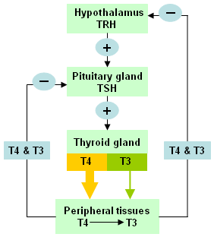
High thyroid levels
suppress TRH
and TSH
Low thyroid levels
stimulate TRH
and TSH to produce
more hormone

Slide 10
Thyroid function tests
TSH measurement:
  Indicates thyroid status
Total T4 or free T4:
  Indicates thyroid status
  Monitors anti-thyroid treatment
  Monitors thyroid supplement treatment
  TSH may take upto 8 weeks to adjust to new level during treatment
  TSH and T4 (total or free) are sensitive, first-line test
  Some labs only measure TSH as first-line test

Slide 11
Thyroid function tests
Total T3 or free T3:
  Rise in T3 is independent of T4
  In some patients only T3 rises (T4 is normal)
  For earlier identification of T3 thyrotoxicosis
Antibodies:
  Diagnosis and monitoring of autoimmune thyroid disease (Hashimoto’s thyroiditis)

Slide 12
Goitre
Enlarged thyroid gland
May be associated with:
  Hypofunction
  Hyperfunction
  Normal function of thyroid gland
Causes:
  Iodine deficiency
  Selenium deficiency
  Hashimoto’s thyroiditis
  Congenital hypothyroidism
  Graves' disease (hyperthyroidism)
  Thyroid cancer

Slide 13
Hypothyroidism
Deficiency of thyroid hormones
Primary hypothyroidism:
  Failure of thyroid gland
Secondary hypothyroidism:
  Failure of the pituitary to secrete TSH (rare)
  Failure of the hypothalamic-pituitary-thyroid axis

Slide 14
Hypothyroidism
Causes:
  Hashimoto’s disease
  Radioiodine or surgical treatment of hyperthyroidism
  Drug effects
  TSH deficiency
  Congenital defects
  Severe iodine deficiency
Clinical features
  Tiredness
  Cold intolerance
  Weight gain
  Dry skin

Slide 15
Hypothyroidism
Diagnosis
  Elevated TSH level confirms hypothyroidism
Treatment
  T4 replacement therapy (tablets)
  Monitoring TSH level to determine dosage
  Patient has to continue treatment for life
Neonatal hypothyroidism
  Due to genetic defect in thyroid gland of newborns
  Diagnosed by TSH screening
  Hormone replacement therapy
  May cause cretinism, if untreated

Slide 16
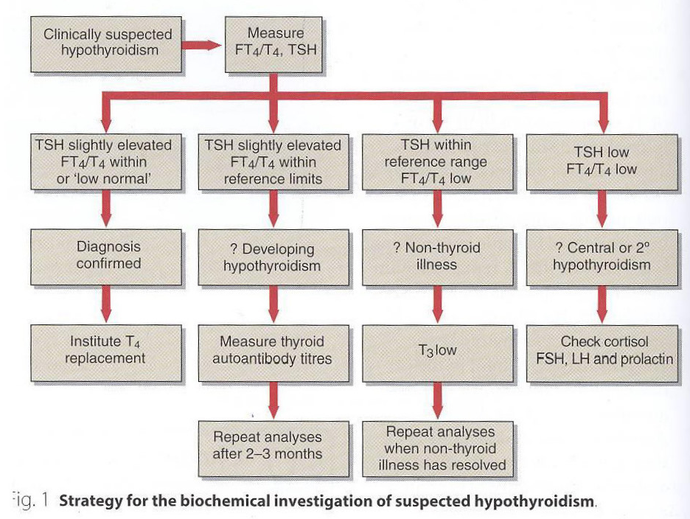

Slide 17
Hypothyroidism
Non-thyroidal illness
  In some diseases, the normal regulation of TSH, T3 and T4 secretion and metabolism is disturbed
  Most of T4 is converted to rT3 (inactive)
  Causing thyroid hormone deficiency
  TSH secretion is suppressed
  Secretion of T4 and T3 is decreased

Slide 18
Hyperthyroidism
Over-activity of the thyroid gland
Increased secretion of thyroid hormones
Tissues are exposed to high levels of thyroid hormones (thyrotoxicosis)
Increased pituitary stimulation of the thyroid gland
Causes:
  Graves' disease
  Toxic multinodular goitre
  Thyroid adenoma
  Thyroiditis
  Intake of iodine / iodine drugs
  Excessive intake of T4 and T3

Slide 19
Cretinism
Most severe and devastating form of Hypothyroidism
Seen with Congenital Thyroid Deficiency in young children
If it is not treated by supplemental therapy , child will suffer from cretinism, a form of irreversible growth and mental retardation
Myxedema
Common symptom of Hypothyroidism arising after early childhood include Lethargy, Fatigue, Cold intolerance, weakness, hair loss and reproductive failure

Slide 20
Hyperthyroidism
Clinical features
Weight loss with normal appetite
Sweating / heat intolerance
Fatigue
Palpitation / agitation, tremor
Angina, heart failure
Diarrhea
Eyelid retraction and lid lag

Slide 21
Hyperthyroidism
Diagnosis
Suppressed TSH level
Raised thyroid hormone level
Confirms primary hyperthyroidism
Problems in diagnosis
Total serum T4 conc. changes due to changes in binding protein levels
In pregnancy, high estrogens increase TBG synthesis
  Total T4 will be high

Slide 22
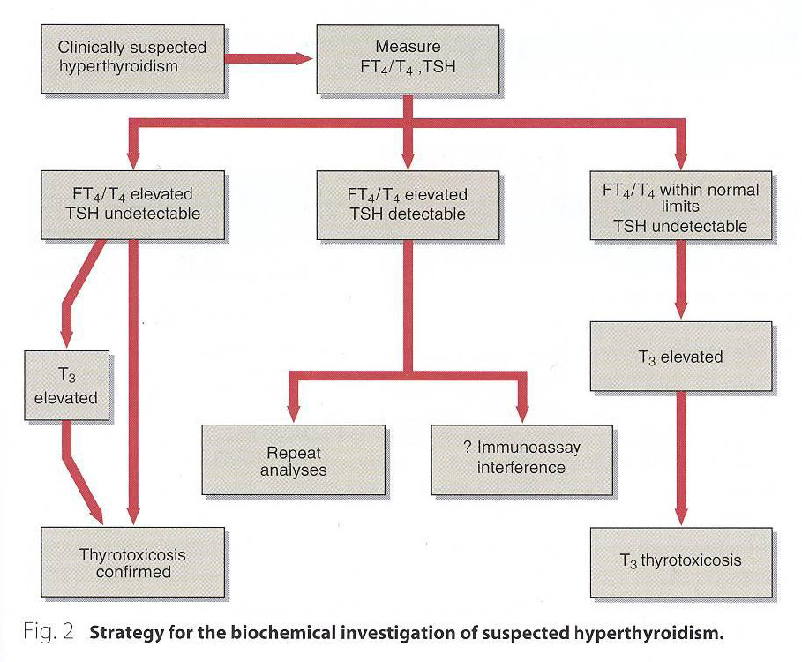

Slide 23
Hyperthyroidism
Congenital TBG deficiency can also influence results
Free T4 and TSH are first-line tests for thyroid dysfunction
Treatment
Antithyroid drugs: carbimazole, propylthiouracil
Radioiodine: sodium ¹³¹I inhibits T4/T3 synthesis
Surgery: thyroidectomy

Slide 24
Graves' disease
Most common cause of hyperthyroidism
An autoimmune disease
Antibodies against TSH receptors on thyroid cells mimic the action of pituitary hormone
Normal regulation of synthesis/control is disturbed
Treated with Ant thyroid Drugs which suppress synthesis of thyroid hormones by interfering with iodination of Tg (Thyroglobulin) by Thyroid Peroxidase

Slide 25
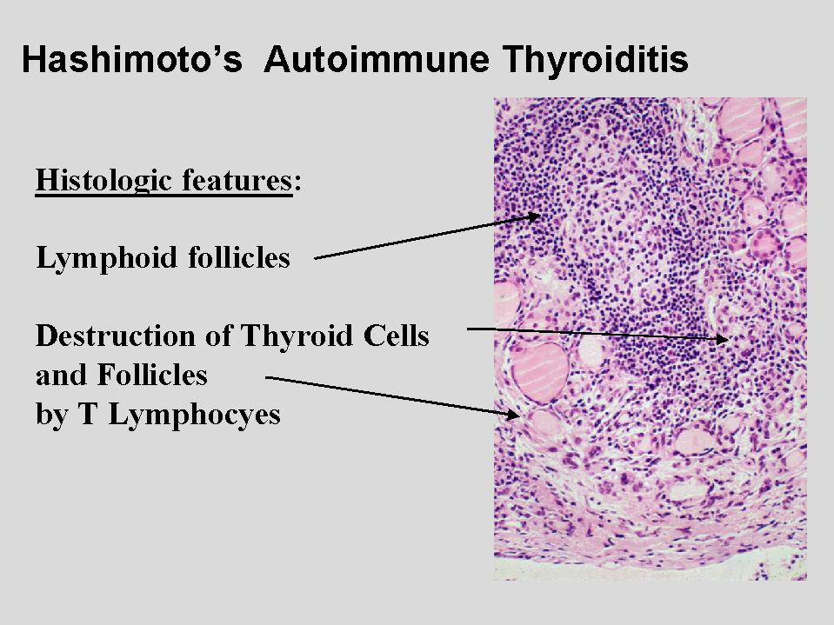
Hashimoto Disease
Autoimmune Disease
Thyroid gland is gradually destroyed by a variety of cell and antibody mediated response
Symptoms: Weight gain, Depression, Mania, Sensitivity to heat and cold, fatigue, Pain attacks
Treated with levothyroxine
or Desiccated Thyroid Extract
( Derived from Domestic
Animals that are used for
food by man like
beef or hog Thyroid)

Slide 26
Drugs used for treatment
Levothyroxine Sodium:
Tightly bound to plasma proteins
Synthetic crystalline sodium salt, slower onset of action than crystalline T3
Administration leads to greater increase in serum T4 but a lesser increase in serum T3.
Used to treat or prevent Goiter, which can be caused by hormone imbalance, radiation treatment, surgery or cancer.

Slide 27
MMI, PTU
Thionamides are major drugs for thyrotoxicosis and hyperthyroidism.
Also called Thioureylene0.
Potent inhibitor of Thyroperoxidase : responsible for iodination of tyrosine residues of Tg
Do not affect on iodide pump or on Thyroid hormone release.
PTU used for treatment of Hyperthyroidism.
Toxic effects on Liver
MMI is longer acting than PTU

Slide 28
Pharmacokinetics
PTU is rapidly absorbed from GIT
Bioavailability 50-80%
Indigested PTU excreted via Kidney as Inactive Glucuronide
80-90% PTU bind to Albumin
MMI is completely absorbed
SIDE EFFECTS
Diarrhea, Vomiting, Skin rash and Agranulocytosis

